Slide 1

Customer Segmentation and Marketing Optimization
Presented By Tamalika Murasing & Mayen Udoffia
Notes:
Line spacing + Page numbers

Slide 2
Agenda
01 Introduction
02 Business Problem
03 Data Dictionary
04 Data Collection & Preprocessing
05 Exploratory Data Analysis
06 Clustering Methodology
07 Cluster Interpretation
08 Actionable Insights
09 Validation & Evaluation
10 The Value of Clustering in Marketing

Slide 3
Introduction
01
In today's rapidly evolving digital landscape, businesses are faced with the formidable challenge of optimizing their online performance to stay competitive and sustainable. Despite the abundance of data and technological advancements, many organizations struggle to effectively harness these resources to drive profitability and enhance brand reputation. From customer engagement to conversion rates, website usability to digital marketing effectiveness, the complexity of online operations demands a comprehensive strategy and framework for analysis and optimization.

Slide 4
Business Problem
02
How can our e commerce cosmetic company effectively leverage their vast customer data to segment their audience, tailor marketing strategies, and optimize digital marketing efforts to drive profitability and enhance brand reputation in the rapidly evolving online landscape?
For Marketing Teams, Product Managers, Customer Experience Teams, Market Researchers, Senior Management to gain deeper insights into customer segmentation and behavior, enhance marketing effectiveness, and drive business growth.

Slide 5
s
Variable | Description | Data Type
event_time | Time when event happened at. | Time Stamp
Event_type | Type of event; purchase, view, cart or remove from cart | Categorical
Product ID | Unique identifier of the product | String/Integer
Category_ID | Category ID for the product | Integer
Category code | Product's category taxonomy (code name) if it was possible to make it. | Categorical/null
Brand | Brand name of the product | Categorical/null
User_id | Permanent User ID, uniquely identifying each User | integer/string
Price | Price of the product | Float
User_session | Temporary user's session ID, which remains the same within each session but changes between sessions | String

Slide 6
DATA PREPROCESSING
Data Cleaning: Handled missing values(category code) and remove duplicates and negative values (price)
Feature Engineering: Extract relevant features and encode categorical variables(created time based features like hour, weekday, set constant value )
Data Transformation: Normalized numerical features like price’ in the range [-1, 1] ,converted categorical variables to factor type
Data Sampling : Randomly Sampling 50,000 records of the data for analysis.
Data Visualization: Explore the preprocessed data through visualization to understand the distribution of features.
Feature Selection : Selected relevant features based on domain knowledge and feature importance analysis.

Slide 7
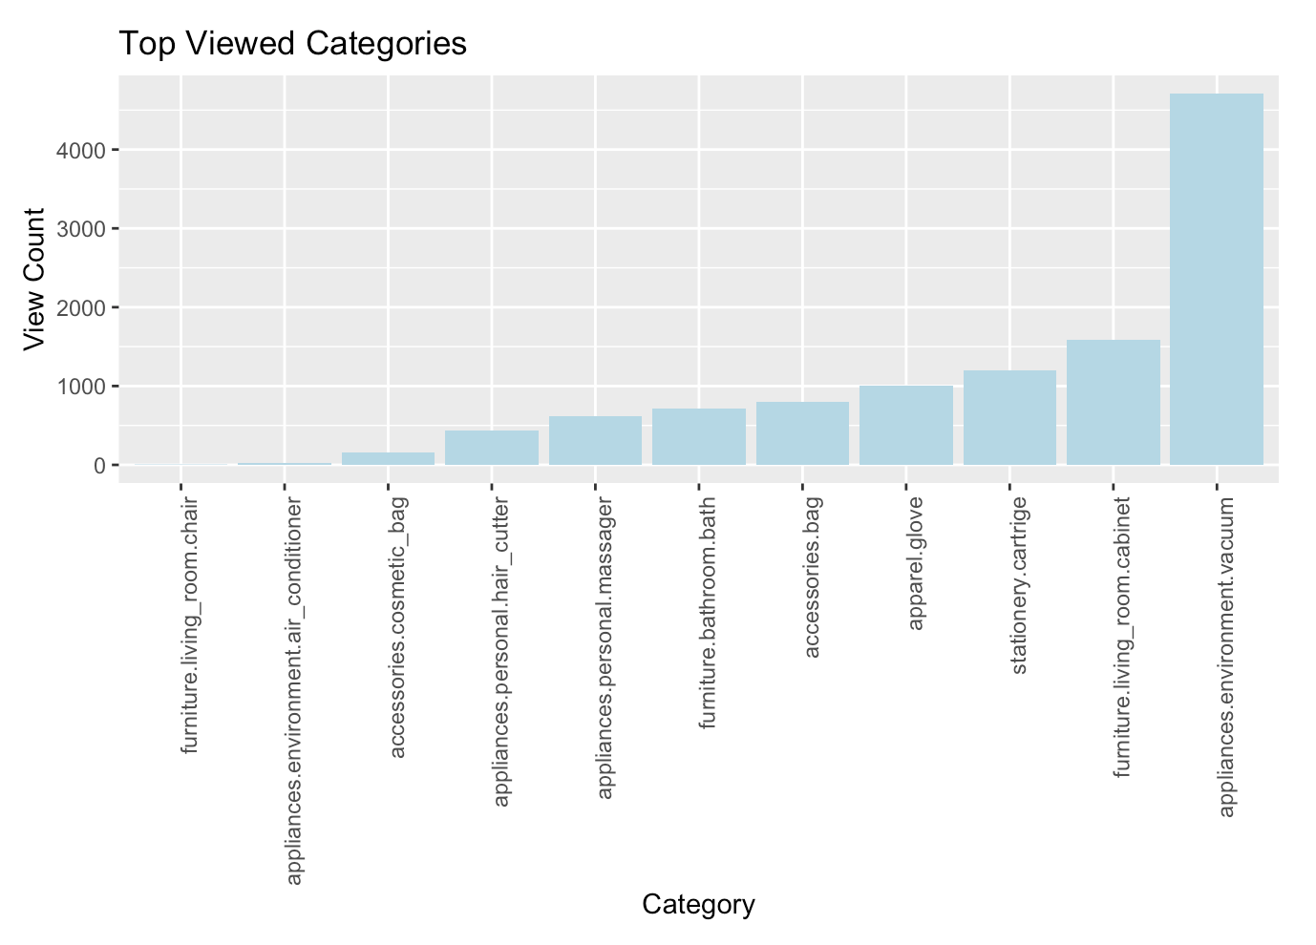
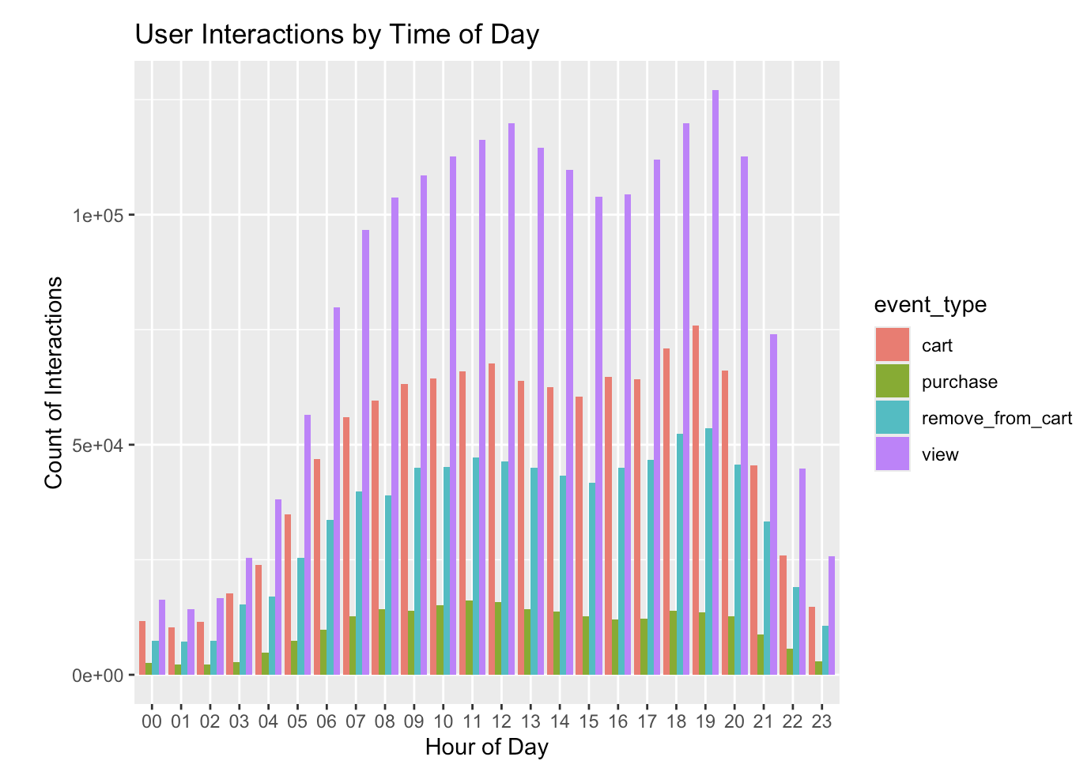
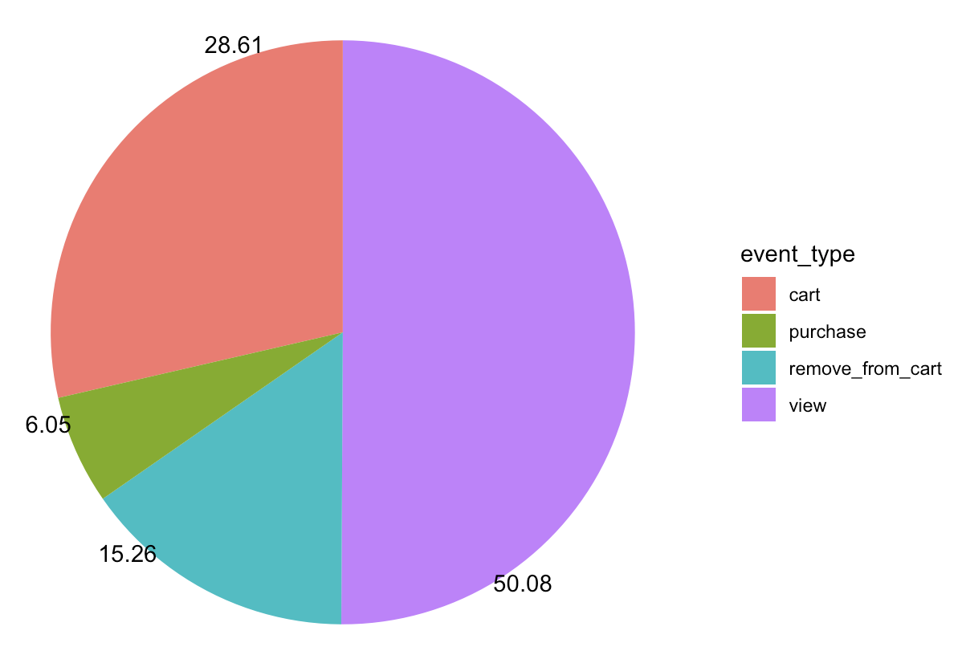
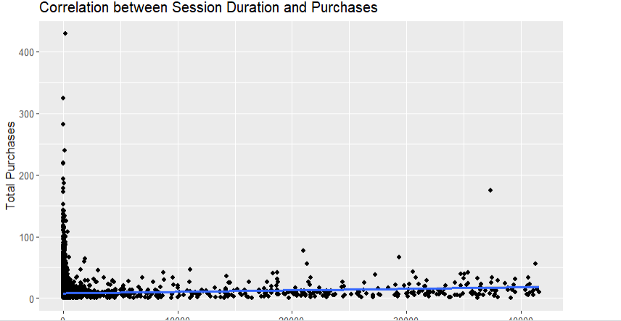
EXPLORATORY DATA ANALYSIS

Slide 8
CLUSTERING METHODOLOGY (K PROTOTYPES)
Evaluate the quality of clustering using Total Within-cluster Sum of Squares, and visually identifying the optimal number of clusters using the elbow method. The optimal number of k is 5.
Kproto function is used because it effectively handle both categorical and numerical data,
Feature Variable Selection: Selected features for clustering: event_type, category_code, brand, price, hour, and weekday, chosen for their relevance to business decisions on resource allocation and investments.

Slide 9
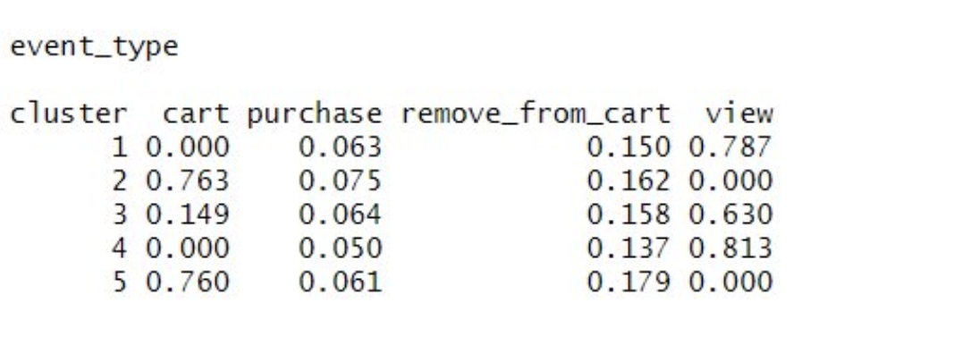
Customer Behavior Segmentation – Event Type
Cluster 1- Users frequently view products but rarely add them to the cart or make purchases, suggesting they might be in the browsing or research phase.
Cluster2 - Users often add items to their cart but seldom complete purchases, indicating hesitancy or barriers to transaction completion.
Cluster3 - users engage in frequent product views with moderate cart additions and low purchase rates, indicating browsing behavior.
Clusters4 - Users highly engage in product views but show minimal cart additions or purchases, suggesting they might be comparing prices or gathering information.
Cluster5 - Users frequently add items to the cart and complete purchases, showing clear buying intent and a higher likelihood of transaction completion

Slide 10
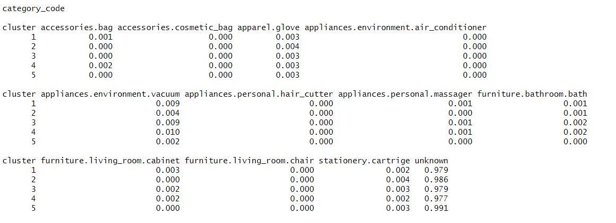
Customer Behavior Segmentation – Category
Cluster1: This cluster shows a preference for home appliances, particularly vacuum cleaners, along with some interest in accessories like bags and bathroom furniture.
Cluster2: Users in this cluster also show interest in home appliances, especially air conditioners and vacuums, along with bathroom furniture.
Cluster3: Similar to Cluster 1, this group demonstrates a preference for home appliances, particularly vacuums, and shows interest in bathroom and living room furniture.
Cluster4: Users in this cluster exhibit similar preferences to Clusters 1 and 3, showing interest in home appliances like vacuums and furniture items for the bathroom and living room.
Cluster5: This cluster predominantly contains unclassified or unknown items, suggesting a diverse range of products or potentially miscellaneous items not fitting into specific categories.

Slide 11
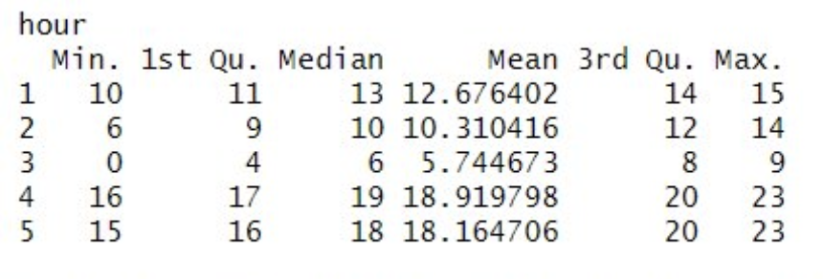
Customer Behavior Segmentation – Time of the day
Cluster1: Moderate hours (mean ≈ 12.68) with values ranging from 10 to 15 hours.
Cluster 2: Varied hours (mean ≈ 10.31), spanning from 6 to 14 hours.
Cluster 3: Low hours (mean ≈ 5.74), with most values falling between 4 and 8 hours.
Cluster 4: High hours (mean ≈ 18.92), ranging from 16 to 23 hours.
Cluster 5: Another high hour's group (mean ≈ 18.16), with values between 15 and 23 hours.

Slide 12
Recommendations
Event Type
Brand
Cluster 1 | Optimize browsing experience by providing personalized product recommendations, incentivize action with discounts/free shipping, and maintain engagement throughtargeted emails featuring viewed products.
Cluster2 | streamline checkout experience with user-friendly design, flexible payment options, and retargeting strategies to reduce hesitancy and overcome transaction barriers.
Cluster 3 | Enhance user support with live chat, facilitate informed decisions with detailed descriptions/reviews/comparisons, and drive conversions through limited-time promotions, encouraging cart additions to purchases.
Cluster 4 | Boost decision-making with price comparisons, detailed product info, and reviews on pages. Ensure confidence with a price match guarantee, optimizing research and securing the best deal.
Cluster 5 | Personalize shopping with complementary product suggestions, loyalty rewards, and tailored follow-ups based on purchase history.
CLUSTER1 | Highlight new accessories for Brand A to capitalize on existing brand loyalty. Offer exclusive deals and promotions specifically for Brand A products to incentivize quick and decisive purchases. Implement targeted marketing campaigns to promote Brand A accessories to loyal customers and encourage repeat purchases.
CLUSTER 2 | Facilitate cross-promotion between Brand A and Brand B accessories to highlight compatibility and versatility. Offer comparison tools to assist customers in evaluating the unique benefits of each brand's accessories. Emphasize the complementary nature of Brand A and Brand B products to cater to customers with balanced preferences.
CLUSTER 3 | Introduce bundling discounts and loyalty rewards for Brand B products and appliances to incentivize purchases. Monitor cart abandonment rates and adjust strategies, such as implementing exit-intent pop-ups or sending abandoned cart reminder emails, to encourage completion of purchases. Optimize checkout with flexible payment options (e.g., installment plans, buy now pay later) and personalized assistance (e.g., live chat support).

Slide 13
Recommended (Time of the Day & User Session)
CLUSTER 1 | Target marketing efforts towards weekdays and weekends. Offer promotions catering to flexible schedules.
CLUSTER 2 | Focus on weekday promotions with occasional weekend involvement. Provide flexible scheduling options to accommodate varied activity hours
CLUSTER 3 | Concentrate marketing efforts on weekdays. Develop weekday-specific promotions to maximize participation.
CLUSTER 4 | Design marketing campaigns for the entire week, with emphasis on weekdays. Offer weekday-specific incentives to capitalize on high weekday occurrence.
CLUSTER 5 | tailor promotions to target weekdays primarily. Implement weekday-exclusive offers to effectively engage this cluster.
13

Slide 14
The Value of Clustering in Marketing
Understanding Customer Behavior
Improved Marketing Strategies
Resource Optimization
Product Development
Competitive Advantage
Customer Retention and Loyalty
Data-Driven Decision Making
Tailor & Target Marketing Messages/ Campaigns

